Slide 1
Welcome to EDUC2323 Computer Programming as a Tool for Learning
Module Leader: Matthew Dean
mjdean@dmu.ac.uk
Gateway 2.76

Slide 2
Plan
A bit about me
Module philosophy
Where did all this come from?
Getting started with Computational Thinking and Algorithms
Thinking about your project and preparing to start your development blog
Introducing Scratch
Practical Programming Task

Slide 3
A Bit About Me
25 Years at DMU
Mostly based in CEM
Recently completed MA in Education
DMU Teacher Fellow
Interested in the Pedagogy of Programming
Why is Education like magic?

Slide 4
Module Philosophy
Workshops will be collaborative and practical – we are building communities of practice (Wenger, McDermott & Snyder, 2002)
On- and off-computer activities = different perspectives on learning
We are concerned about teaching, learning and thinking first, technology second
Computers and technology are ‘objects to think with’ – they offer ‘windows into learning’
We are learning conceptual building blocks, not specific technologies
Interdisciplinary approaches – people with different backgrounds encouraged to share expertise
There are no stupid questions – absolutely none…

Slide 5
Module Structure
Development Project
Blog
Workshop structure (2 hours)
Web site
Sprint meetings
Scrum meetings
Take a look at the handbook
Set up teams

Slide 6
Where did all this come from?
Is IT teaching up to scratch?
The ancient language our kids lack: computer code
' Dull' computer classes to be ditched
University applications are falling in exactly the subjects that are increasingly needed.
Classrooms must support the UK's technology boom
Program or be Programmed!
British teenagers can't code. Until they learn how to, they're stuffed - and so is the UK
IT teaching faces shake-up after Google criticism
Programming should take pride of place in schools

Slide 7
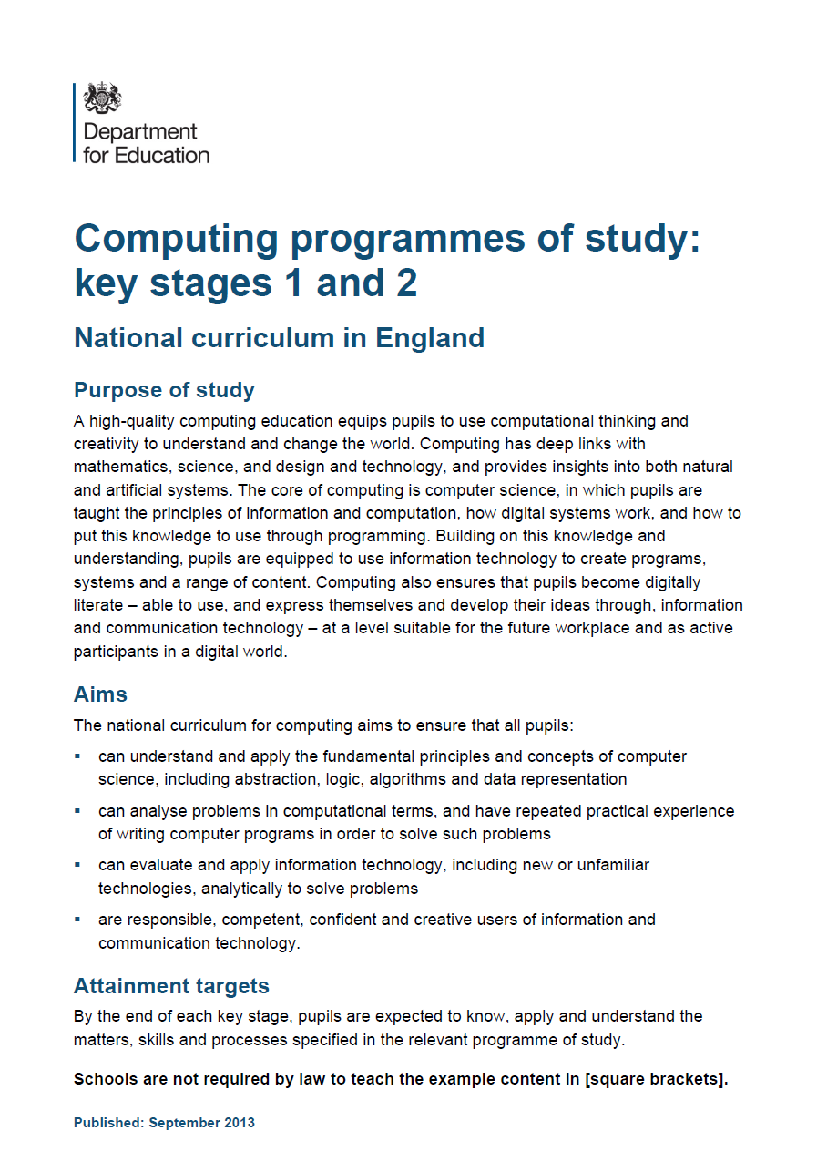

Where did all this come from?

Slide 8
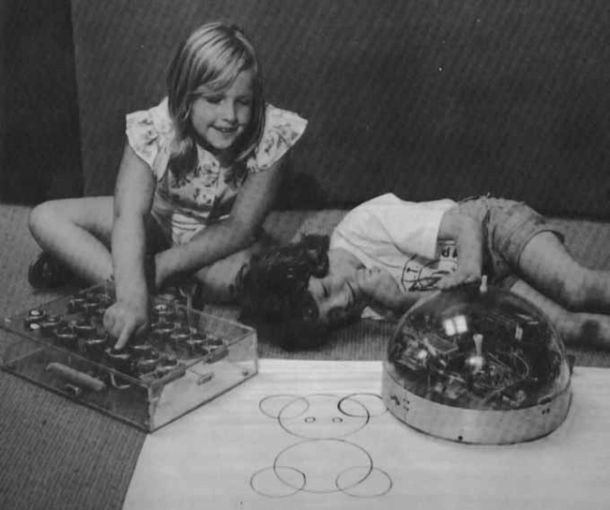
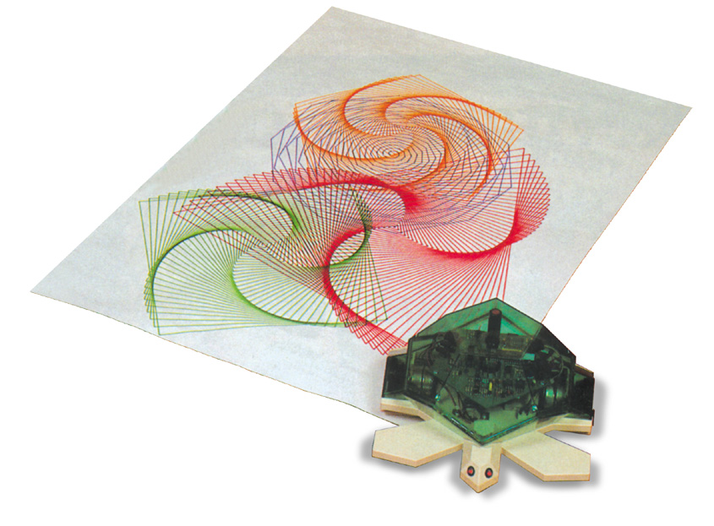
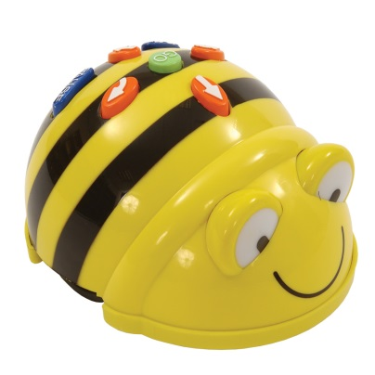
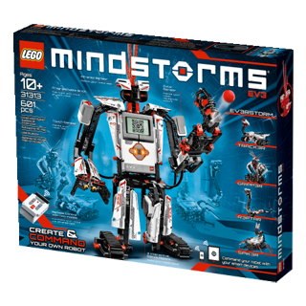
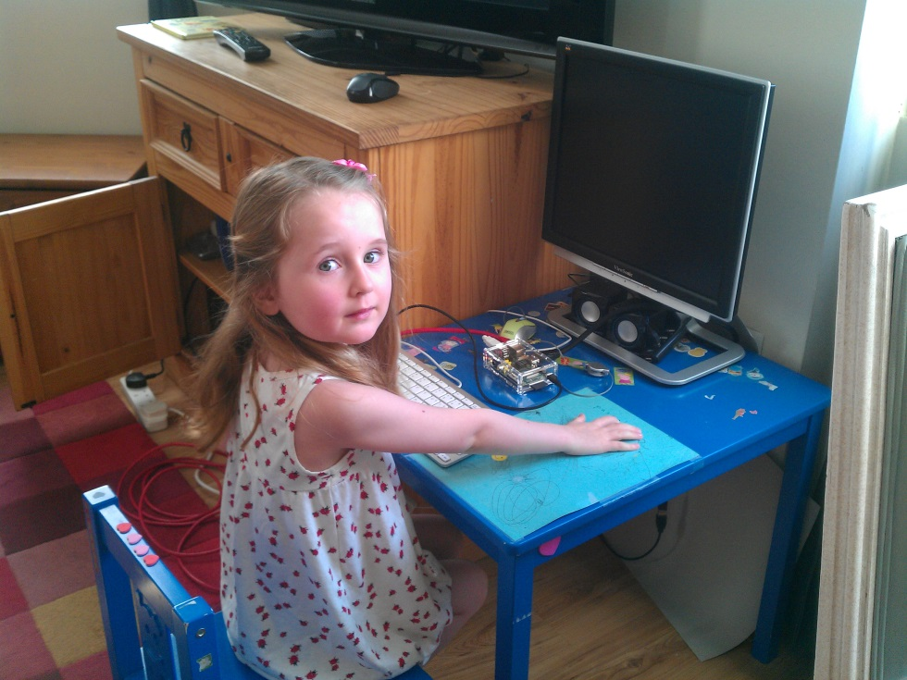
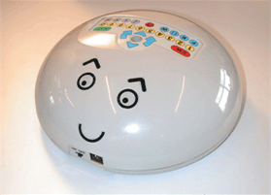
The funny thing is none of this is very new…
The ‘Valiant’ Turtle
Preface to Papert’s Mindstorms (1981)
The Raspberry PI
Bee-Bot
Lego Mindstorms
The ‘Valiant’ Roamer

Slide 9
Anyway, let’s do some meaningful learning…

Slide 10
How do two people have a conversation?
Try it now… Discuss your favourite breakfast with the person next to you.
How does it work? Can you try to write down a set of ‘rules’ which would guide two people to have a conversation?

Slide 11
An ‘algorithm’…
…is a precisely defined procedure – a sequence of instructions, or a set of rules, for performing a specific task (e.g. instructions for changing a wheel or making a sandwich).
While all correct algorithms should produce the right answer, some algorithms are more efficient than others.
Computer scientists are interested in finding better algorithms, partly out of intellectual curiosity, and partly because improvements in algorithms can result in massive savings in terms of both cost and time.

Slide 12
Splitting problems into smaller parts is part of computational thinking.
For example, designing a game in Scratch will involve thinking about algorithms, programming, drawing sprites and backgrounds, making animations, and even composing music or recording sound effects.

Slide 13
Thinking forward to the practical project and your development blog
Small-scale, practical programming project
Bottom line when coming up with ideas for your project:
“The submitted project should feature learning through exploration or experimentation. In very simple terms, someone should learn something by doing something. It may be you doing the learning as the project’s developer, or someone else doing the learning as the project’s end user (perhaps a hypothetical school pupil) The ‘richer’ you can make the learning in the project, either for you as the developer or for someone as the user, the more potential there is for your project to do well.”

Slide 14
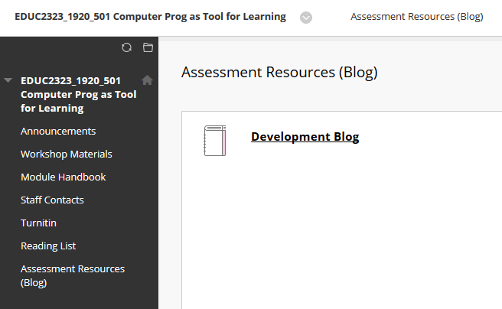
Where do I find my blog?
Accessible via Blackboard
This task has exactly the same expectations as a standard written task:
Well written, good language usage and expression
Properly evidenced and referenced – good citation practices
Is entirely your own work – other people’s quotes, ideas, images, project, code etc all cited
All blogs will be submitted to Turnitin for plagiarism check

Slide 15
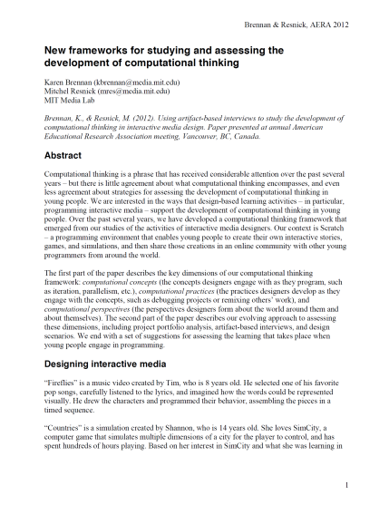








For next time…
Definitely read p1-11 and 22-24 of Brennan & Resnick (2012) on BB – and read the whole article if you have a chance
Try to link it to what we have covered in today’s workshop
The article mentions many more scratch blocks (e.g. repeat, if and operator blocks) – see if you can play with these using scratch – try to find out what they do and how they can be used to enrich algorithms
Have a play with Scratch and see if you can learn about these blocks and how they work

Slide 16
Hands-on Activity
Assessment brings together two strands
Theoretical basis for using programming as a tool for learning (Blog)
Developing an educational tool using Scratch (System)
Each workshops should provide ideas on how to get started with the two strands and pull them both together

Slide 17
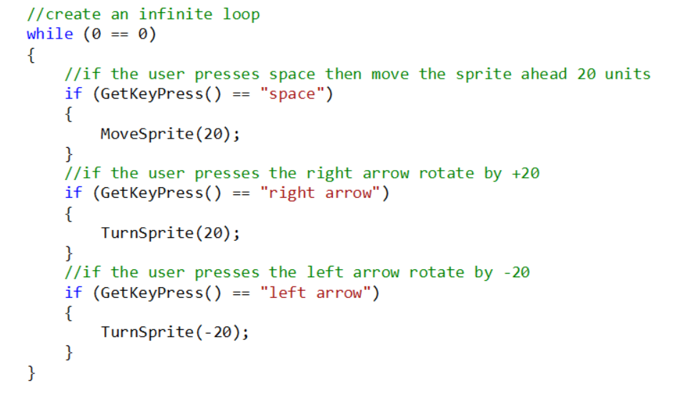
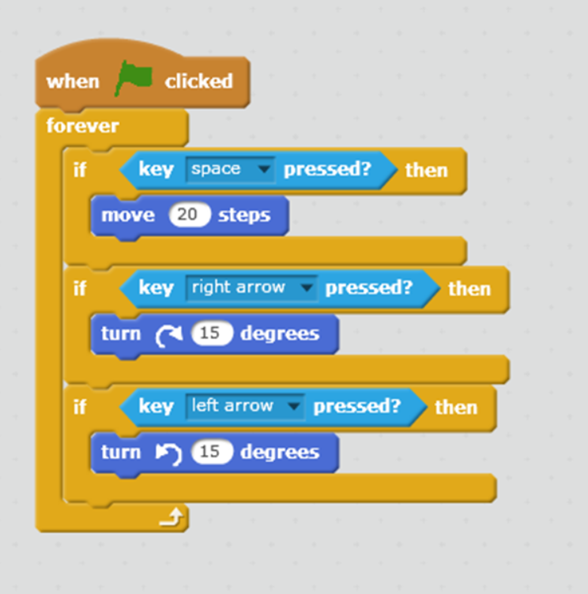
Scratch versus Written Code

Slide 18
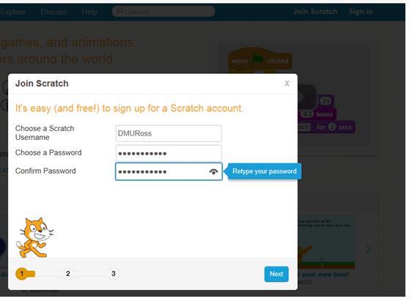
Let’s have a look at Scratch
Point your browser at http://scratch.mit.edu/
Scratch is an online environment (you must have Flash installed) but…
You can install a version ‘off line’ on your own computer
Set yourself up with an account (‘Join Scratch’) so you can save your work
Once you are logged in to Scratch, go to ‘Create’.

Slide 19
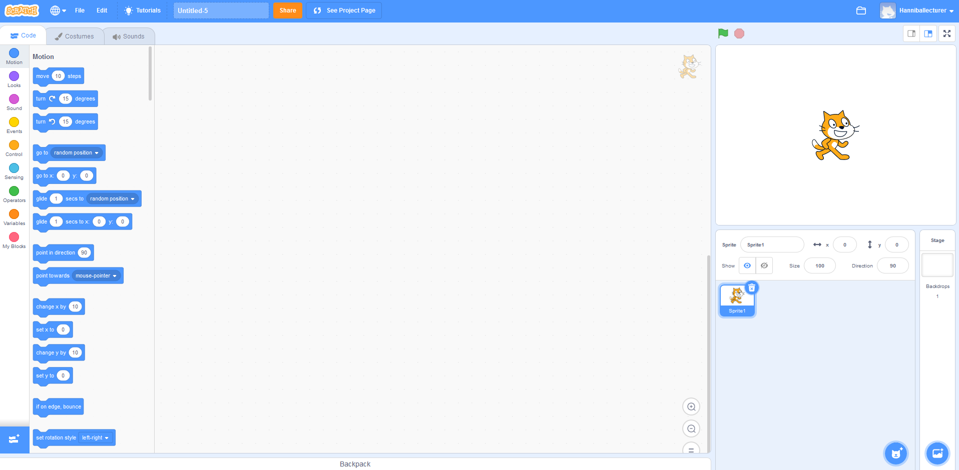

Slide 20
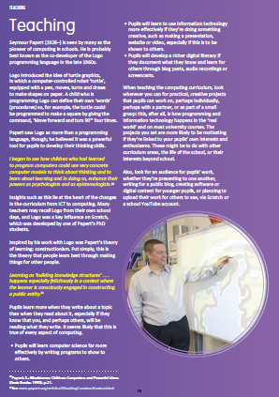
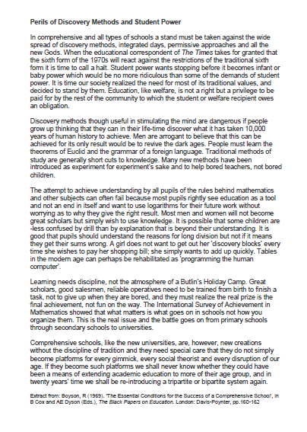



Programming Task
1. In pairs, read through the extracts from Berry (2013) and Boyson (1969) – try to get a good grasp of the differing points of view that these extracts represent.
2. Using:
your ‘conversation algorithm’
these three blocks in Scratch
Imagine a conversation that might take place between Seymour Papert and Rhodes Boyson - how will their views on learning differ, do you think?
Hint: you are going to need two sprites (of your choice!), controlled by two scripts to make this work.
This project takes much from Phil Bagge’s ‘Conversation’ Project – see the original at: http://www.code-it.co.uk/scratch/scratchplan.html

Slide 21


Extension task…
Can you make Seymour and Rhodes’ conversation take place at a disco?
You could try using the following blocks
And also find a ‘suitable backdrop’

